Slide 1


Analytical Case Study
“A Comprehensive Analysis of Sales Data for Strategic Decision-Making"
Presented by: Hayah Ahmed

Slide 2
Introduction
Data Exploration
Analytical Questions
Important:
I’ve written SQL queries using the Oracle Application Express (APEX) development environment.
Visualizations for the retrieved data are created using Python libraries.
To keep things organized, the code for these functionalities is stored in separate files.
else refer to this repo:
https://github.com/hayahahmed08/BAZAAR-SUBMISSION
Visualisations
Additional Insights/findings
Recommendations
Agenda

Slide 3

Case Study
Overview
In this case study, I analyzed sales transactions from a retail company to improve business performance. I employed SQL querying for data exploration, addressing key metrics like total orders, sales revenue, and average order quantity. Analytical questions focused on discount rates, revenue distribution, and customer spending patterns. Using data visualization tools, I created charts and graphs to illustrate trends and insights. Finally, I provided actionable recommendations to optimize sales strategies and enhance overall performance.
BACK TO AGENDA

Slide 4
Data Exploration
01
02
03
Total number of orders
Total sales revenue
Average order quantity
SQL QUERY:
SELECT COUNT(*) AS total_orders
FROM sales_data;
SQL QUERY:
SELECT SUM(amount_per_unit * ordered_quantity) AS total_sales_revenue FROM sales_data
WHERE order_status = 'CLOSED';
SQL QUERY:
SELECT ROUND(AVG(ordered_quantity), 2) AS average_order_quantity
FROM sales_data;
25000
88403552.725
22.84
BACK TO AGENDA

Slide 5
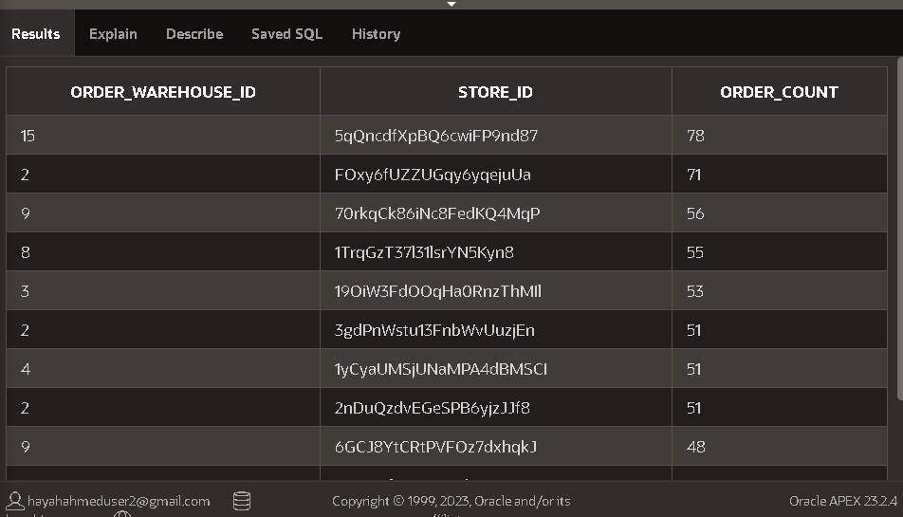
Data Exploration
Output of first few rows:
04
Distribution of orders by warehouse and store
SQL QUERY:
SELECT order_warehouse_id, store_id, COUNT(*) AS order_count
FROM SALES_DATA
GROUP BY order_warehouse_id, store_id;
BACK TO AGENDA

Slide 6
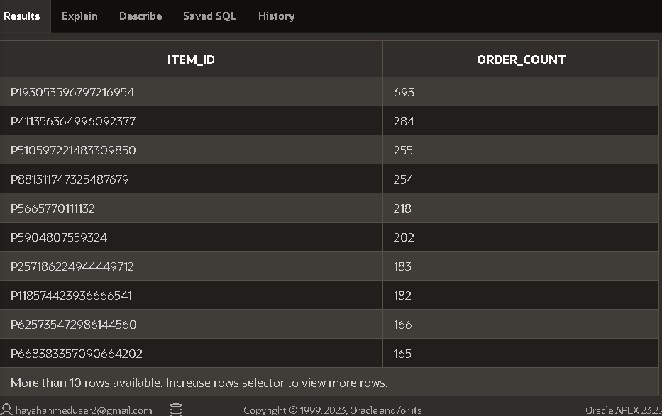
Data Exploration
Output of first few rows:
05
Top selling items
SQL QUERY:
SELECT DISTINCT item_id, COUNT(ordered_quantity) AS order_count
FROM SALES_DATA
GROUP BY item_id
ORDER BY order_count DESC;
BACK TO AGENDA

Slide 7
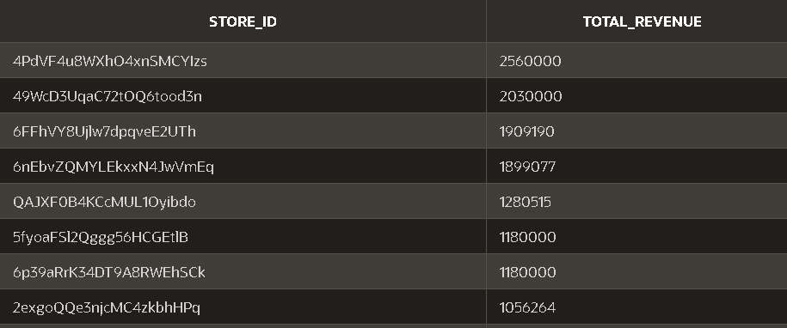
Analytical Questions
Q1
Q2
What is the total revenue generated by each store?
Which warehouse has the highest average order value (total sales revenue divided by number of orders)?
SELECT store_id,
SUM(amount_per_unit * ordered_quantity - item_discount) AS total_revenue
FROM SALES_DATA
WHERE order_status = 'CLOSED'
GROUP BY store_id
ORDER BY total_revenue DESC;
SELECT order_warehouse_id, ROUND(AVG(amount_per_unit * ordered_quantity),2) AS avg_order_value
FROM SALES_DATA
GROUP BY order_warehouse_id
HAVING order_warehouse_id is not NULL
ORDER BY avg_order_value DESC;
"The analysis reveals that Warehouse 14 boasts the highest average order value, with an average of $76,146.67 per order
BACK TO AGENDA

Slide 8
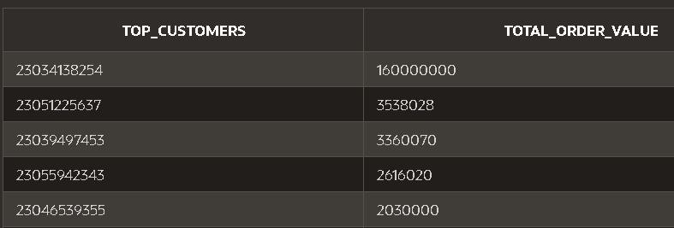
Analytical Questions
Q3
Q4
What is the overall discount rate (average discount per item sold)?
Identify the top 5 customers (based on total amount spent).
SELECT ROUND(AVG(item_discount / (amount_per_unit * ordered_quantity)),2) AS avg_discount_rate
FROM SALES_DATA
WHERE amount_per_unit > 0 AND ordered_quantity > 0 AND item_discount > 0;
SELECT order_number AS top_customers,
SUM(amount_per_unit * ordered_quantity) AS total_order_value
FROM SALES_DATA
GROUP BY order_number
ORDER BY total_order_value DESC;
"The overall discount rate, calculated as the average discount per item sold, is found to be 0.03."
BACK TO AGENDA

Slide 9
Analytical Questions
Q5
Calculate the week-over-week growth rate of sales revenue.
SELECT TO_CHAR(TO_DATE(order_date, 'DD/MM/YYYY'), 'IW') AS week, SUM(amount_per_unit * ordered_quantity) AS weekly_revenue, ROUND( ( SUM(amount_per_unit * ordered_quantity - item_discount) - LAG(SUM(amount_per_unit * ordered_quantity)) OVER (ORDER BY TO_DATE(order_date, 'DD/MM/YYYY')))
/ LAG(SUM(amount_per_unit * ordered_quantity)) OVER (ORDER BY TO_DATE(order_date, 'DD/MM/YYYY')) * 100, 2) AS growth_rate FROM SALES_DATA_FINAL
WHERE TO_DATE(order_date, 'DD/MM/YYYY') >= TO_DATE('01/02/2023', 'DD/MM/YYYY') AND TO_DATE(order_date, 'DD/MM/YYYY') <= TO_DATE('28/02/2023', 'DD/MM/YYYY')
GROUP BY TO_CHAR(TO_DATE(order_date, 'DD/MM/YYYY'), 'IW') ORDER BY TO_CHAR(TO_DATE(order_date, 'DD/MM/YYYY'), 'IW');
Assumption: The question asks to calculate month-over-month growth but the given dataset is of the month of Februrary, so months can’t be compared therefore i’ve performed week over week growth rate of sales revenue.
BACK TO AGENDA

Slide 10
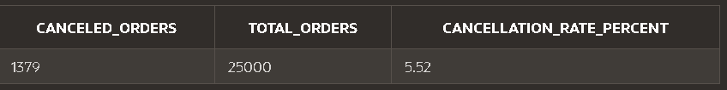
Analytical Questions
Q6
Determine the percentage of orders that were canceled
SELECT
COUNT(CASE WHEN order_status = 'CANCELLED' THEN 1 ELSE NULL END) AS canceled_orders,
COUNT(*) AS total_orders,
ROUND((COUNT(CASE WHEN order_status = 'CANCELLED' THEN 1 ELSE NULL END) / COUNT(*)) * 100, 2) AS cancellation_rate_percent
FROM SALES_DATA;
BACK TO AGENDA

Slide 11
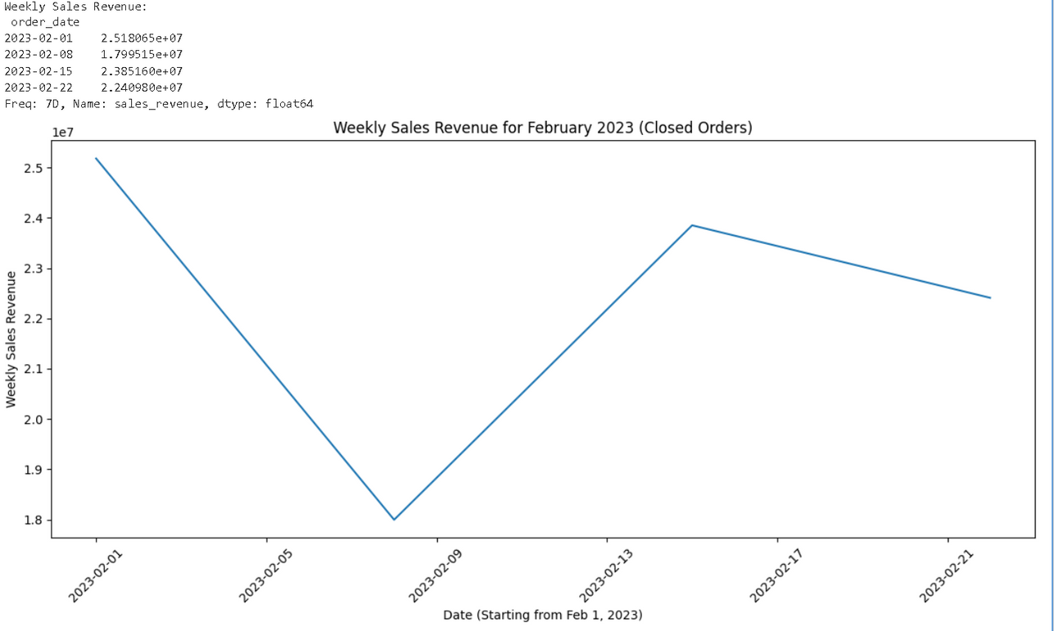
Sales Revenue Over time
Analysis
The weekly sales revenue for February 2023 shows a fluctuating pattern rather than a clear trend. There's a dip in revenue during the first week, followed by a significant jump in week two. While week three maintains a similar level of sales to week two, week four dips again.
Python code given in separate file
BACK TO AGENDA

Slide 12
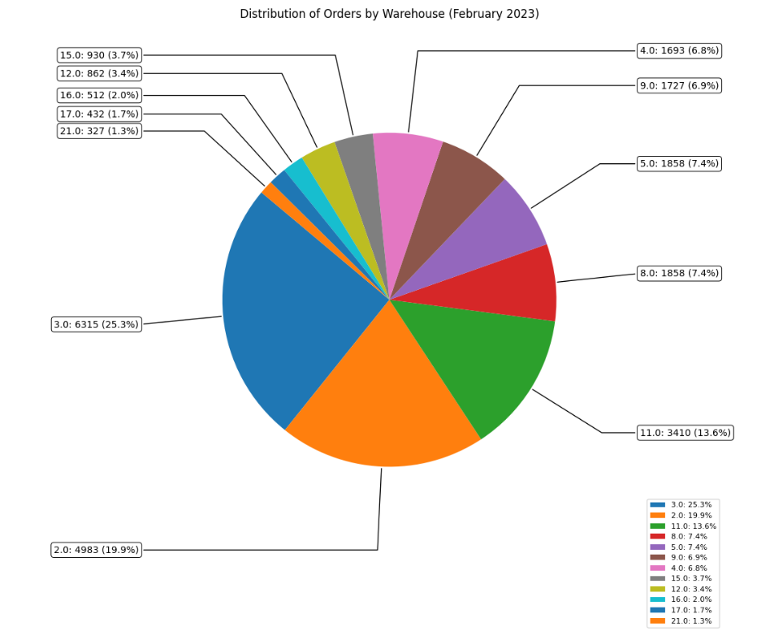
Distribution of Orders by Warehouse
Analysis
Warehouse 3.0 has the most orders at 6315, which accounts for 25.3% of the total orders.
Warehouse 2.0 follows with 4983 orders, which is 19.9% of the total orders.
Warehouse 11.0 has 13.6% of the total orders, which is 3410 orders.
Warehouse 5.0 and 8.0 each account for 7.4% of the total orders, which is 1858 orders each.
The remaining warehouses, 4.0, 9.0, 12.0, 15.0, 16.0, 17.0, and 21.0, account for a combined total of 18.7% of the total orders.
Python code given in separate file
BACK TO AGENDA

Slide 13
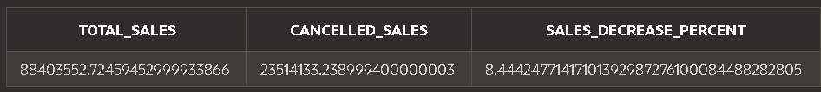
Additional Insights/Findings
01
how much sale is decreased due to order status cancellation
SELECT
SUM(CASE WHEN order_status = 'CLOSED' THEN amount_per_unit * ordered_quantity - item_discount ELSE 0 END) AS total_sales,
SUM(CASE WHEN order_status = 'CANCELLED' THEN amount_per_unit * ordered_quantity - item_discount ELSE 0 END) AS cancelled_sales,
CASE WHEN SUM(amount_per_unit * ordered_quantity) > 0 THEN
SUM(CASE WHEN order_status = 'CANCELLED' THEN amount_per_unit * ordered_quantity - item_discount ELSE 0 END) /
SUM(amount_per_unit * ordered_quantity) * 100
ELSE 0 END AS sales_decrease_percent
FROM sales_data;
Due to order cancellation the totalsales is affectied by approx 8.5%
BACK TO AGENDA

Slide 14
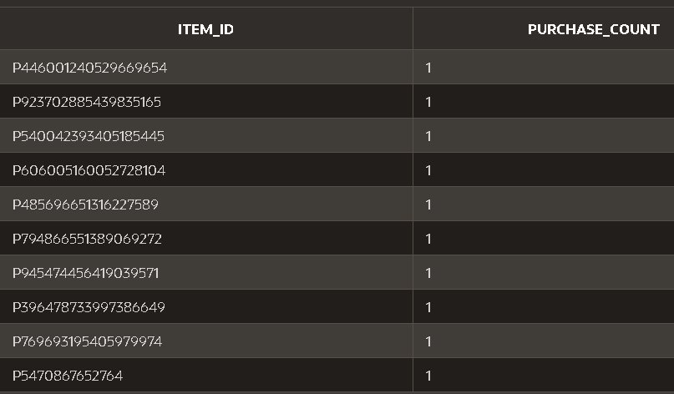
Additional Insights/Findings
02
identify items that customers were least interested in
purchasing
SELECT item_id, COUNT(DISTINCT order_number) AS purchase_count
FROM sales_data
WHERE order_status = 'CLOSED' -- Consider only completed orders
GROUP BY item_id
ORDER BY purchase_count ASC;
More than 10 items have just purchase count of 1
BACK TO AGENDA

Slide 15
Recommedations
for increased sales
Investigate what these stores with the highest total revenue have in common (e.g., location, product mix, marketing strategies).
Analyze stores with lower revenue. Consider targeted promotions or discounts for these stores to boost sales and attract customers. You could offer temporary price reductions, bundle deals, or loyalty program incentives.
Analyze order cancellation data to understand reasons for lost sales and develop strategies to address them.
Identify products frequently purchased together.Recommend complementary products (cross-selling) or higher-value versions (upselling) at checkout or through targeted campaigns.
BACK TO AGENDA

Slide 16



Get In Touch
Email
Linkedin
Call
hayahahmeduser2@gmail.com
https://www.linkedin.com/in/hayah-ahmed/
+92-3363717227
BACK TO AGENDA

